Slide 1
Matplotlib
Data visualization helps to tell stories by curating data into a form easier to understand, highlighting the trends and outliers. A good visualization tells a story, removing the noise from data and highlighting useful information.

Slide 2
Importance of data visualization
Faster decision-making
Data visualization definition
Identify patterns
Data visualization presents data beautifully
Improved data understanding
Interactive visualizations
Communication and collaboration
Effective communication
Enhanced data analysis
Simplifies complex data
Storytelling
Helps identify misleading information
Increases accessibility
Saves time

Slide 3
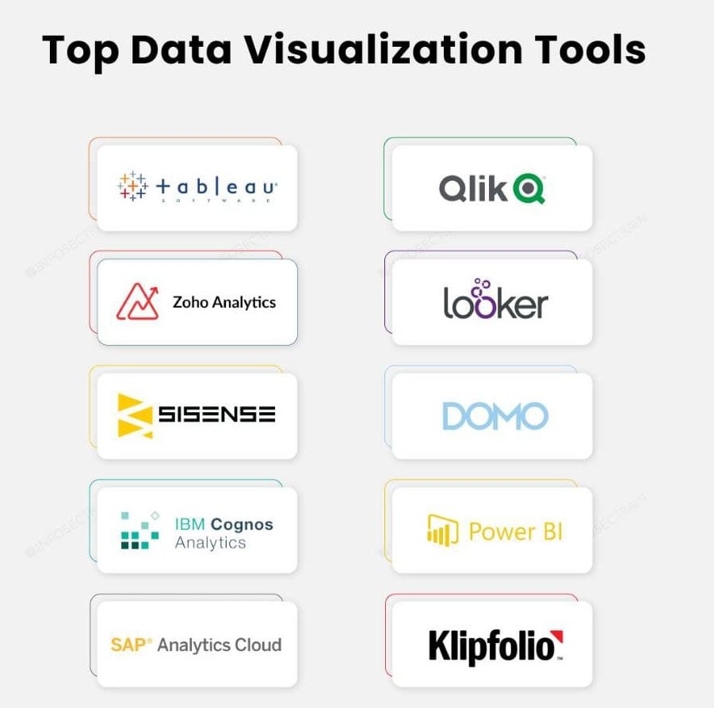

Slide 4
What is Matplotlib?
Matplotlib is a low level graph plotting library in python that serves as a visualization utility.
Matplotlib was created by John D. Hunter.
Matplotlib is open source and we can use it freely.
Matplotlib is mostly written in python, a few segments are written in C, Objective-C and Javascript for Platform compatibility.

Slide 5
Installation of Matplotlib
pip install matplotlib
import matplotlib
print(matplotlib.__version__)
Note: two underscore characters are used in __version__.
import matplotlib.pyplot as plt

Slide 6
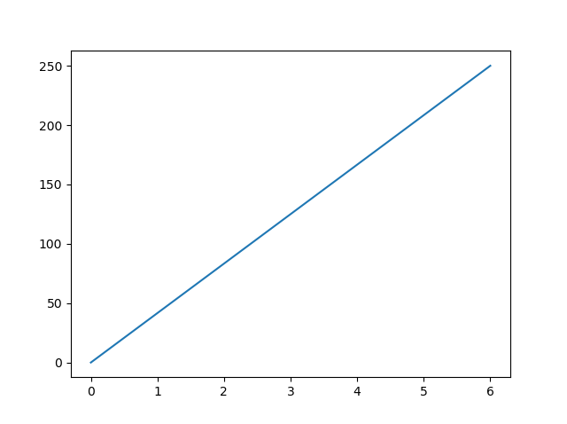
import matplotlib.pyplot as plt
import numpy as np
xpoints = np.array([0, 6])
ypoints = np.array([0, 250])
plt.plot(xpoints, ypoints)
plt.show()

Slide 7
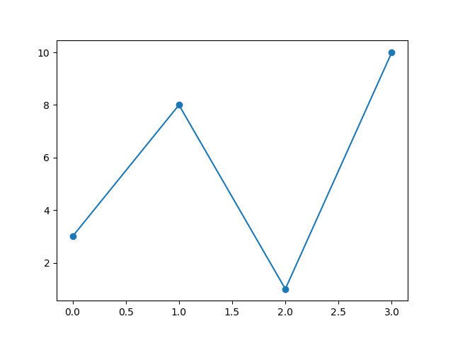
import matplotlib.pyplot as plt
import numpy as np
ypoints = np.array([3, 8, 1, 10])
plt.plot(ypoints, marker = 'o')
plt.show()

Slide 8
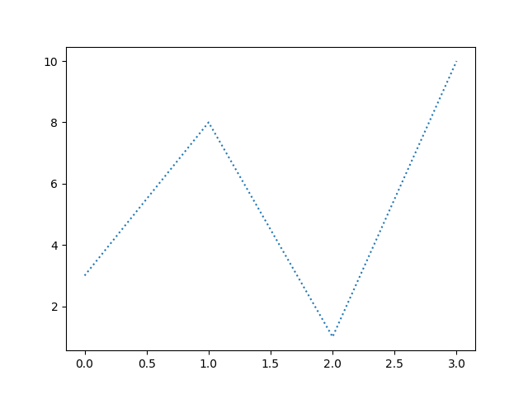
import matplotlib.pyplot as plt
import numpy as np
ypoints = np.array([3, 8, 1, 10])
plt.plot(ypoints, linestyle = 'dotted')
plt.show()

Slide 9
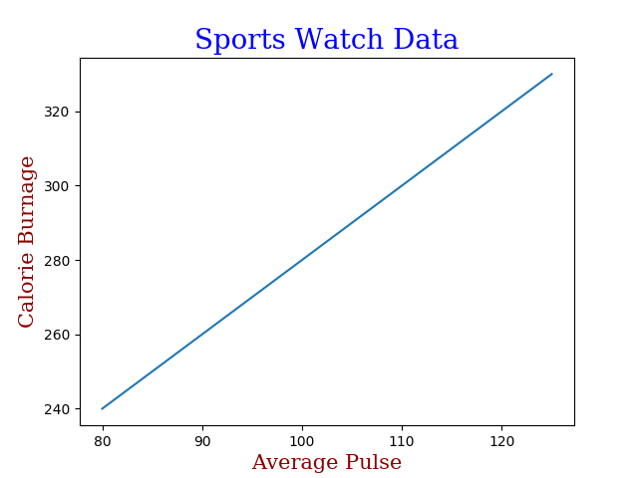
import numpy as np
import matplotlib.pyplot as plt
x = np.array([80, 85, 90, 95, 100, 105, 110, 115, 120, 125])
y = np.array([240, 250, 260, 270, 280, 290, 300, 310, 320, 330])
font1 = {'family':'serif','color':'blue','size':20}
font2 = {'family':'serif','color':'darkred','size':15}
plt.title("Sports Watch Data", fontdict = font1)
plt.xlabel("Average Pulse", fontdict = font2)
plt.ylabel("Calorie Burnage", fontdict = font2)
plt.plot(x,y)
plt.show()

Slide 10
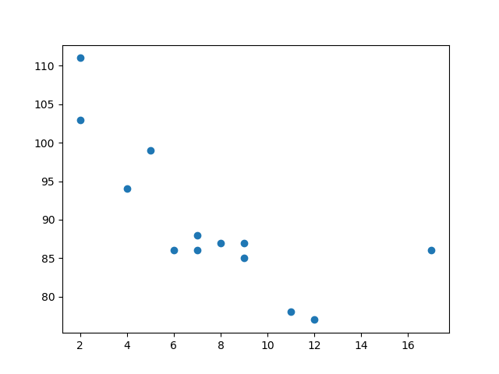
Scatter Plots
import matplotlib.pyplot as plt
import numpy as np
x = np.array([5,7,8,7,2,17,2,9,4,11,12,9,6])
y = np.array([99,86,87,88,111,86,103,87,94,78,77,85,86])
plt.scatter(x, y)
plt.show()

Slide 11
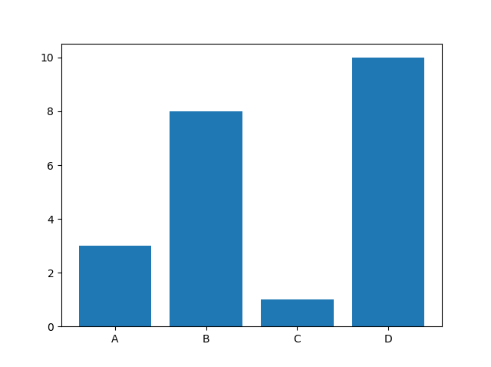
Bars
import matplotlib.pyplot as plt
import numpy as np
x = np.array(["A", "B", "C", "D"])
y = np.array([3, 8, 1, 10])
plt.bar(x,y)
plt.show()

Slide 12
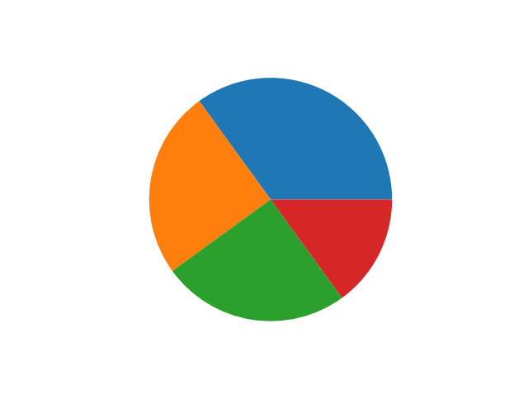
Pie Chart
import matplotlib.pyplot as plt
import numpy as np
y = np.array([35, 25, 25, 15])
plt.pie(y)
plt.show()

Slide 13
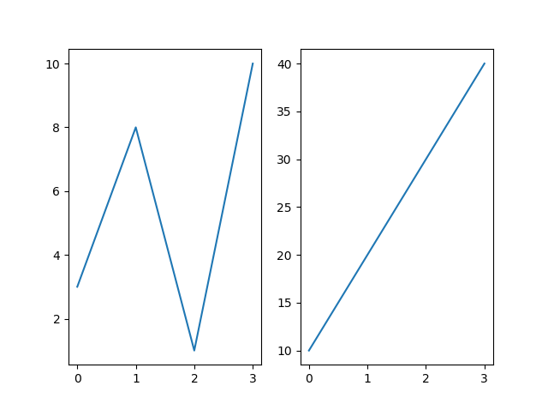
import matplotlib.pyplot as plt
import numpy as np
#plot 1:
x = np.array([0, 1, 2, 3])
y = np.array([3, 8, 1, 10])
plt.subplot(1, 2, 1)
plt.plot(x,y)
#plot 2:
x = np.array([0, 1, 2, 3])
y = np.array([10, 20, 30, 40])
plt.subplot(1, 2, 2)
plt.plot(x,y)
plt.show()

Slide 14
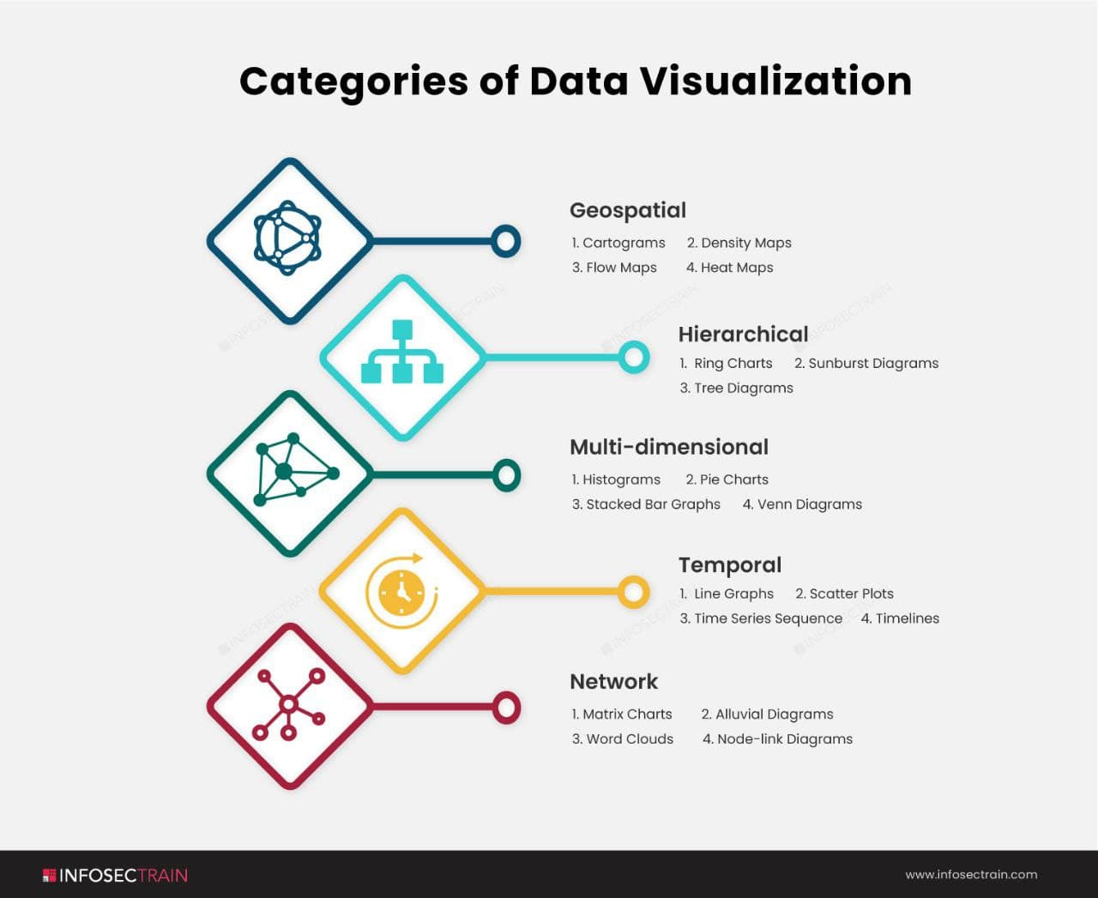

Slide 15
Categories of Visualization
Geospatial: Geospatial data visualization combines maps and data points to represent real-world locations. Geospatial data visualization is frequently used in market penetration studies.
Hierarchical: When presenting data clusters, the hierarchical technique classes data within larger groups and is frequently used, especially if the data comes from a solitary site of origin.
Multi-dimensional: This method creates a three-dimensional data visualization by combining two or more variables.
Temporal: Visualizations of temporal data should be sequential and one-dimensional. This method employs lines that can stand by themselves or coincide and a start and end time frame.
Network: The network method demonstrates relationships between datasets without resorting to lengthy explanations.

